Slide 1
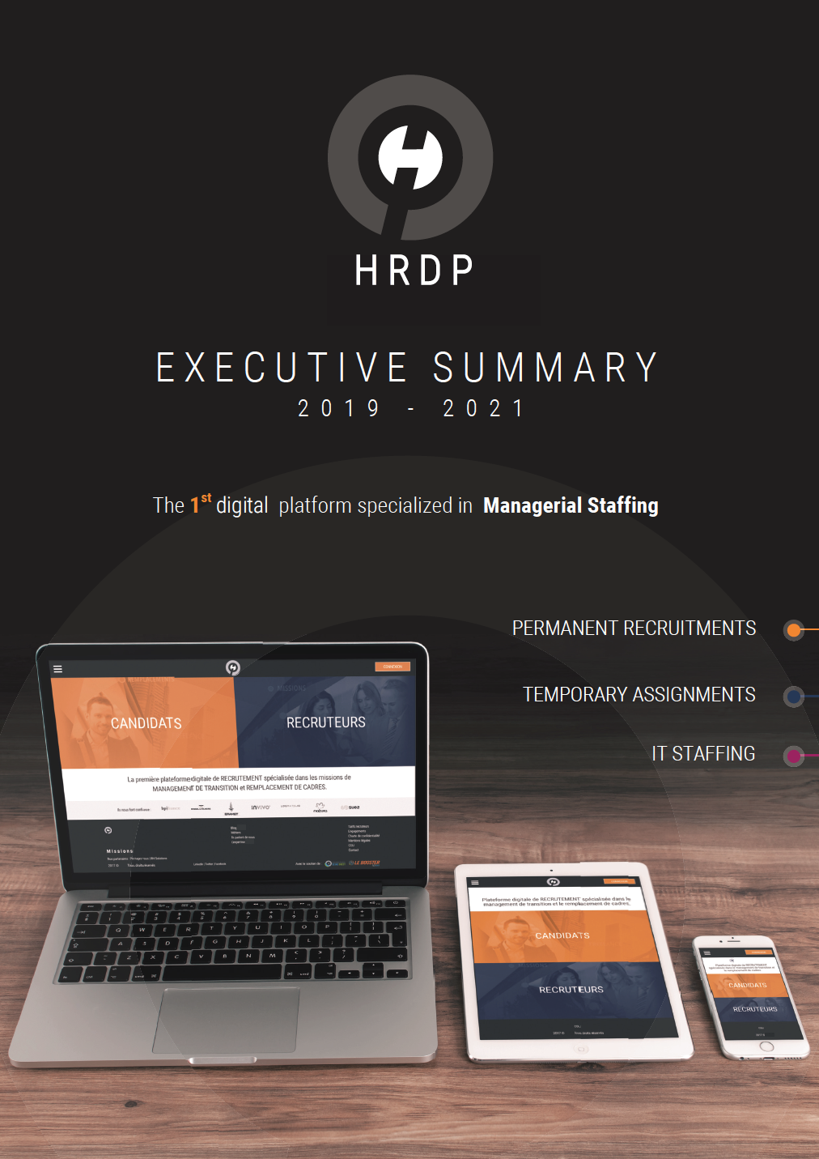







Slide 2

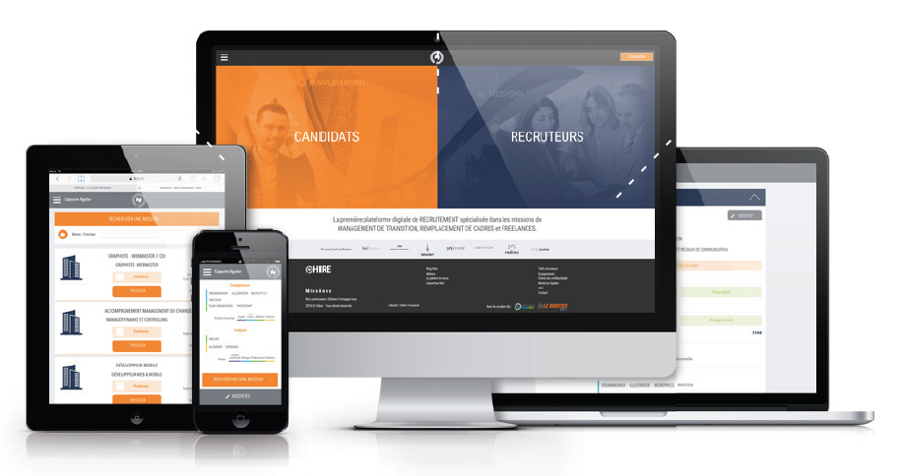


EXECUTIVE SUMMARY
HRDP*.FR is the 1st Digital Platform specialized in Managerial staffing
HRDP’s technology changes the global recruitment approach:
Created in 2015, the digital platform was strategically dedicated to Interim Management & Replacement Assignments, now extended to Permanent Recruitment & IT Staffing.
Its officially rewarded home made technology includes a highly sophisticated Matching Algorithm that computes hard & soft skills between candidates’ profiles and companies’ requirements.
HRDP develops a powerful and detailed Database with already 2 800 candidates and 152 companies registered and targets 4 000 users registered by the end of 2018.
Through an intelligent and friendly multi-devices and fully responsive website (phones, tablets, laptops and desktops), the Team HRDP delivers high level services to companies & candidates: strong reduction of searching delays, more processes transparency, recruitment cost optimizations (-25%).
Based on its digital marketing actions and tech features, HRDP has been listed as one of the top 50 French recruitment start ups.
HRDP proposes its services on a 10% annual growth market and locks clients with an specific sales strategy.
HRDP’s clients: SUEZ, SAUR, KFC, YMAGIS, GENERALI, ERAMET, SAFARI Technologies, NATURA, ARAMIS Auto, ENGEL & VÖLKERS…
Based on its technology, HRDP launches a New Hub concept: a bringing order platform between HR companies.
* HRDP: HR Digital Platform
FRENCH MANAGERIAL RECRUITMENT MARKET
CONFIDENTIAL – DO NOT COPY

Slide 3

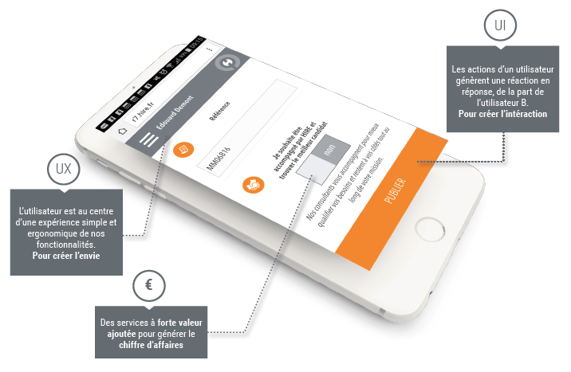
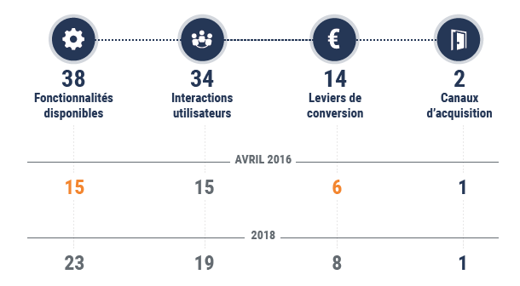
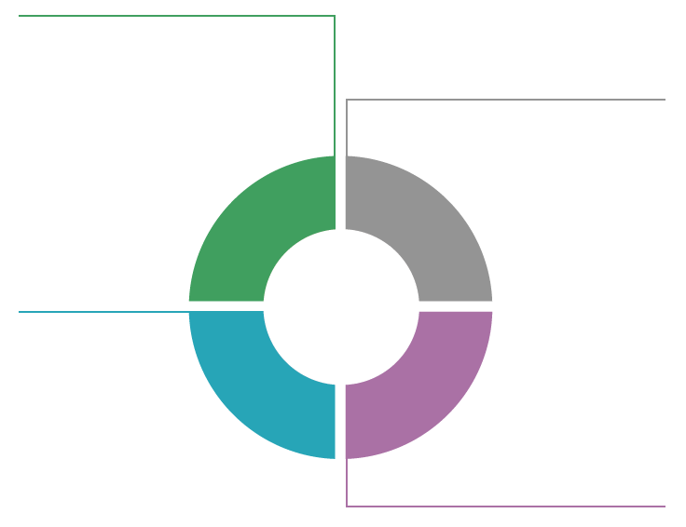
3 BUSINESS LINES BASED ON HRDP’S TECHNOLOGY
2015 – 2017
ASSIGNMENTS
CANDIDATES
2018 – 2021
ASSIGNMENTS & PERMANENT
& IT STAFFING SERVICES
HRDP
2015
HRDP
2018
2019
HRDP.FR
HRDP.TECH
Digital Platform specialized in Managerial Staffing (Permanent & Temporary)
The 1st business bringing platform between recruitement companies
IT Consulting Services
(Assignments)
Listed Companies &
Medium Sized Companies
CLIENTS
IT SUPPORT COMPANIES
& START UP
HRDP: A DIGIMAIN* COMPANY
The actions of a User A occur a reaction in response from a User B.
To create interaction.
Available
features
User
interactions
Converting
levers
Acquisition
channels
The user is at the center of a simple & ergonomic experience of our features.
To create the desire.
April 2016
2019
High value-added services to generate revenues.
* Digital in support of the Human
Digital
Platform
Matching Algorithm
Hard & Soft Skills
Back
Office
Candidates
Registrations
Applications
Companies
Registrations
Recruitment Orders
Interviews
Recruitement Proposals
Companies’
IT Department
Registrations
Recruitment Orders
Interviews
Recruitment Proposals
Registrations
Recruitment Orders
Recruitiment Companies
CONFIDENTIAL – DO NOT COPY

Slide 4
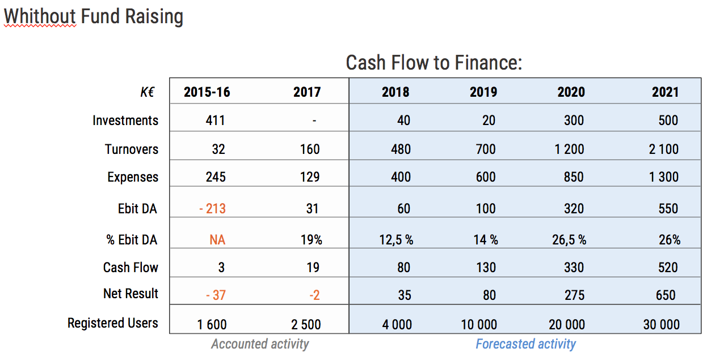
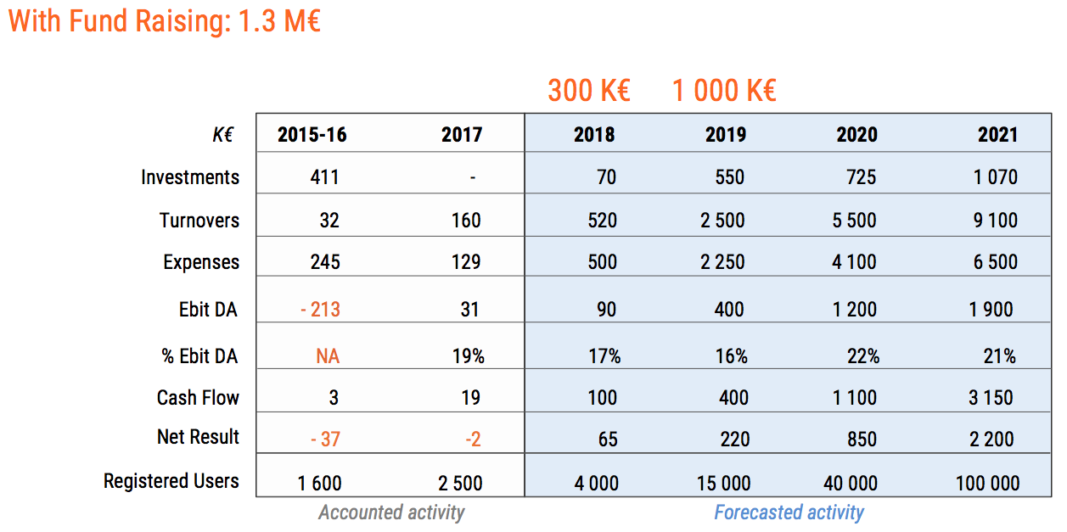
KEY FIGURES
From Jan. 1st 2018 to July 30th 2018: 200 K€ Turnover.
HRDP has already overpassed 2017 global Turnover.
CONFIDENTIAL – DO NOT COPY

Slide 5
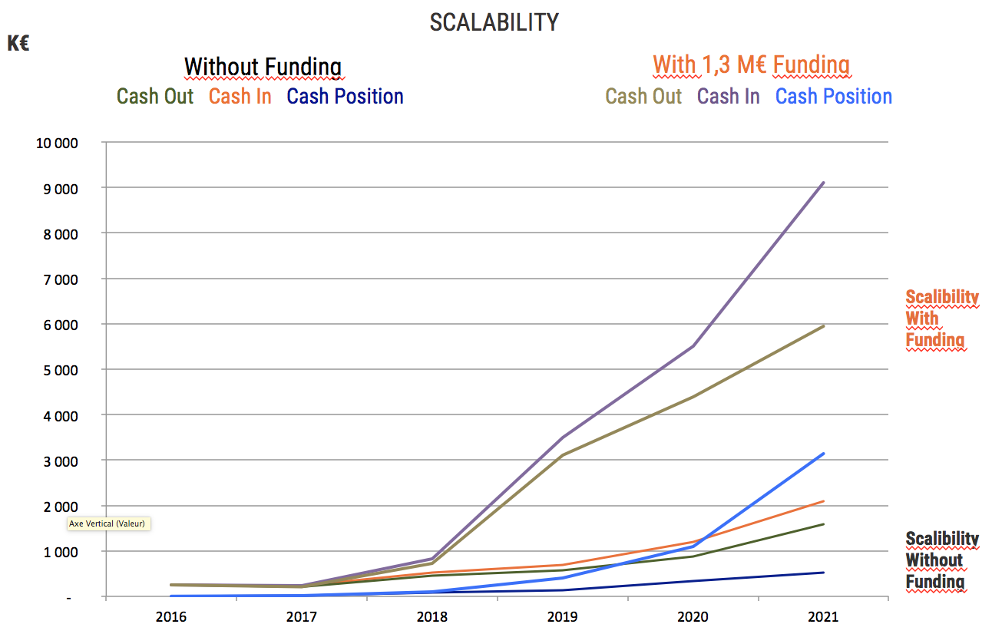
KEY FIGURES
RECRUITMENT MARKET POSITIONING
HRDP
CONFIDENTIAL – DO NOT COPY

Slide 6
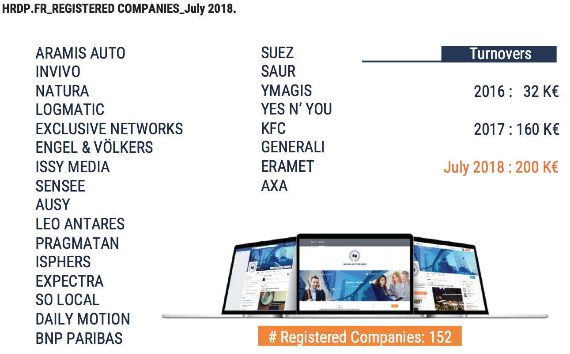
CLIENTS
ACTIVITY
CONFIDENTIAL – DO NOT COPY

Slide 7
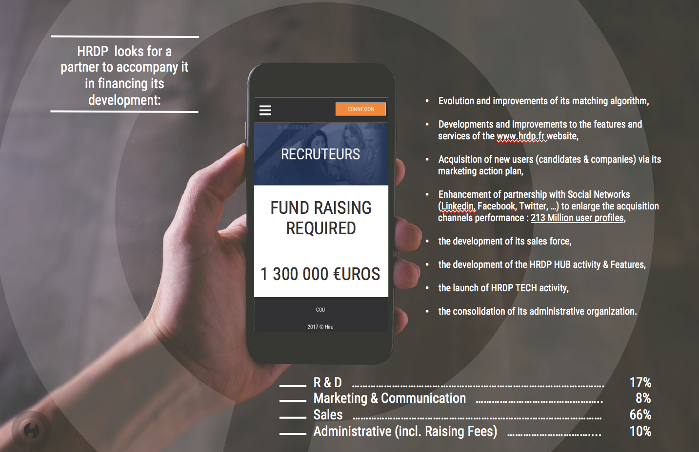

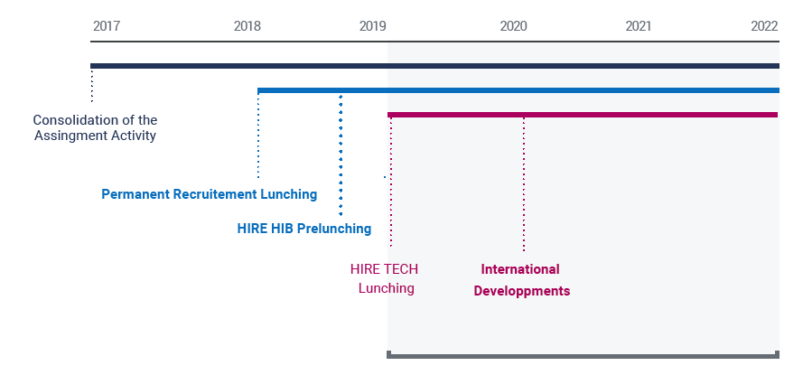

INVESTMENT REQUIRED
Investments
Permanent Recruitment Launching
HRDP HUB Prelaunching
HRPDTECH
Launching
HRDP
CONFIDENTIAL – DO NOT COPY

